Slide 1

Customer Segmentation: Online Retail
A Springboard Capstone Project
Eduardo Mosada Jr.

Slide 2
The Problem:
How can an online retailer target specific groups of customers for its marketing campaigns and strategies based on their purchasing patterns?

Slide 3
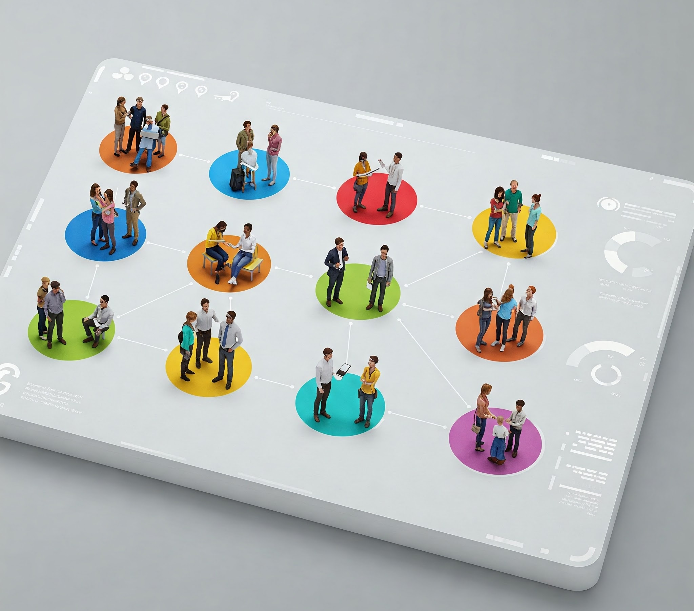
Objectives:
Valuable insights into customer purchasing behavior
Customer-centric data anchored on RFM features
Segmented customers based on RFM analysis.
Benefits:
Better understanding of customers' behaviors and ever-changing needs
Targeted Marketing Campaigns/Strategies
Enhanced Customer Experience
Drive innovative and creative solutions
Boost product sales and profitability
Promising outlook for the future

Slide 4

The Data:
UK-based all-occasion gift-ware online retailer
500,000+ transactions in 2010
4,000+ customers recorded
Data Source: UCI Machine Learning Repository | Online Retail II

Slide 5
Data Wrangling
541,910 Sales transactions in 2010
25 % Blank Customer IDs - 135,080
1.6 % Negative values in quantity – 8,905
1 % Duplicate records – 5,192
72.5%: Records retained – 392,733

Slide 6
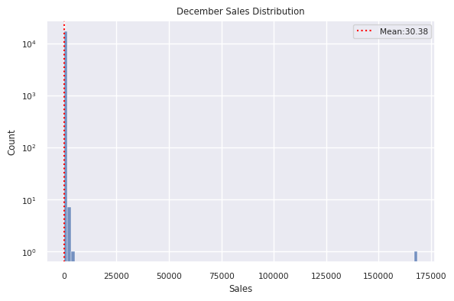
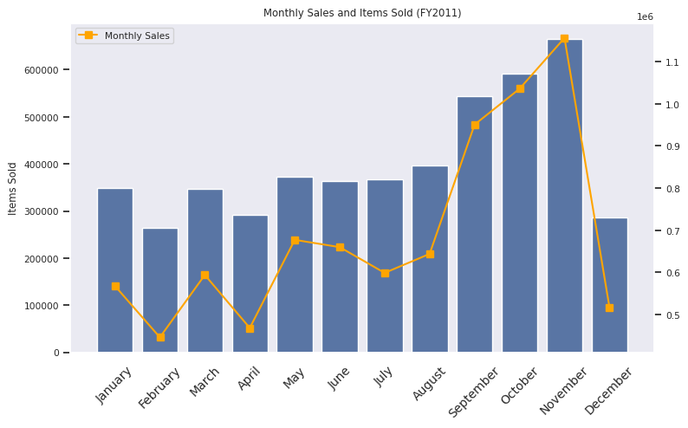
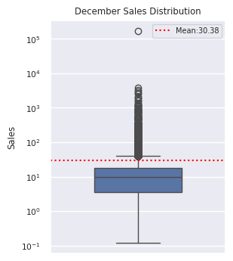
Exploratory Data Analysis
Analysis of 55% Dip in December Sales
392,733 Records for EDA
40 Zero-Priced items
2,560 Out of range Invoices
367,023 Records processed
17,132 Invoices
4,219 Customer IDs
3,596 Stock codes
36 Countries
Huge number of low-value transactions
December only accounted for 5% of the total transactions for the current year
Last transaction is December 9
Incomplete transactions

Slide 7
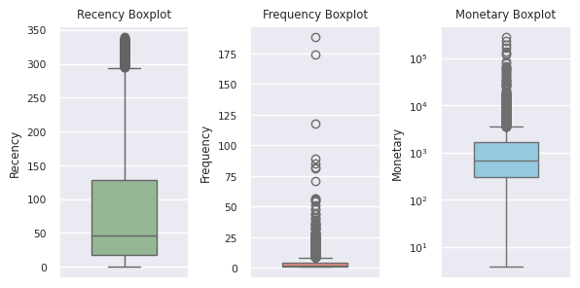
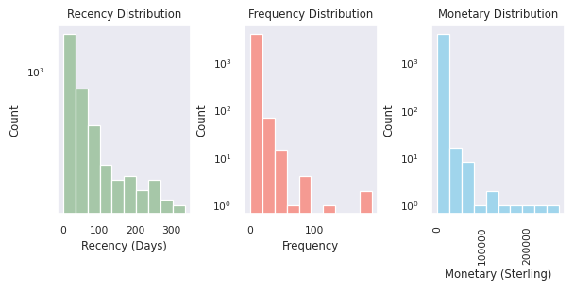
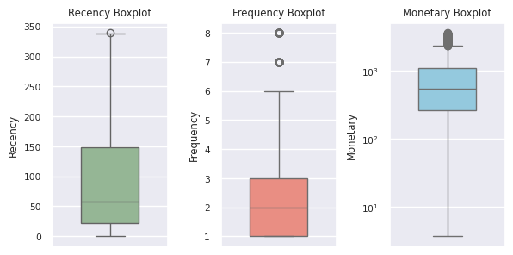
Pre-Processing
Dealing with outliers
Feature Engineering
Recency - How long since the customer's last purchase date?
Frequency - How many transactions did the customer have?
Monetary - How much was spent by the customer?
Outliers for further analysis
402 Monetary outliers
412 Frequency outliers
269 M x F outliers
Non-outliers for modeling
87 % Non-outliers – 3647
3,647 – Scaled data

Slide 8
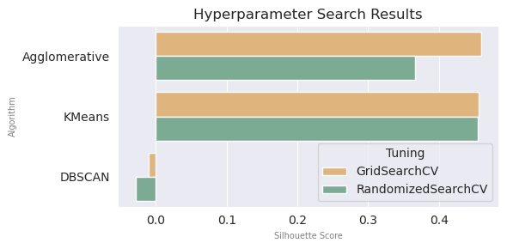

Clustering Algorithm Options
KMeans Clustering
Agglomerative Hierarchical Clustering
DBSCAN
Hyperparameter Seach Implementation
Modeling
3 clustering algorithms
2 Cross-Validation (Nested CV)
Scoring function: Silhouette Score

Slide 9
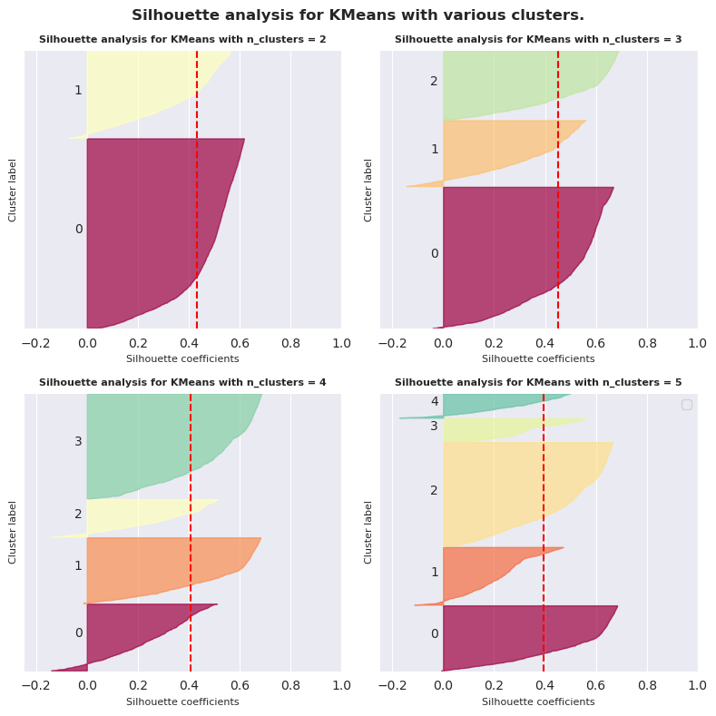
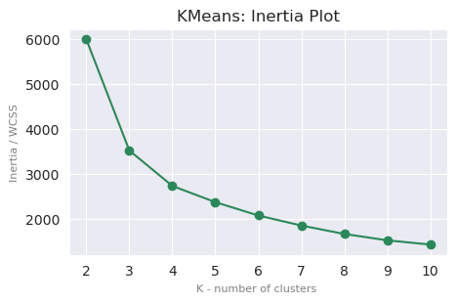
Modeling cont’d.
Cross-Validation vs. Sequential Model-Based Optimization SMBO Search
Optimal K- no. of clusters: Silhouette Analysis
Tuning | Inertia | Silhouette Score
SMBO | 5989.735 | 0.432
RandomizedSearchCV | 3521.054 | 0.453
GridSeachCV | 3517.192 | 0.453
SMBO hyperparameters:
algorithm : 'lloyd’
init: 'random’
max_iter: 645
n_clusters: 2
n_init: 5
tol: 0.1
Optimal K- no. of clusters : Inertia Plot
-- Elbow point
Deciding between n_clusters= 3 and 4 -> Silhouette Analysis
Optimal K- no. of clusters: 3

Slide 10
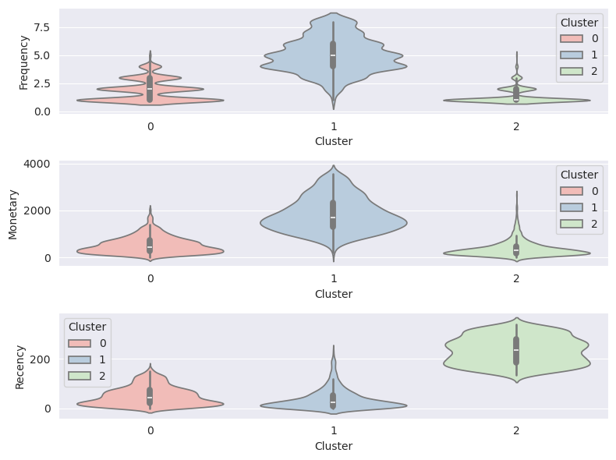
Modeling cont’d.
Cluster Analysis
Assigning Labels
Cluster 0: Moderate
Moderately frequent buyers
Not necessarily high spenders
Majority made recent purchases
Cluster 1: Loyal
Frequent buyers
High spenders
Majority made recent purchases
Cluster 2: At-Risk
Least active recently
Less frequent buyers
Low-spenders

Slide 11
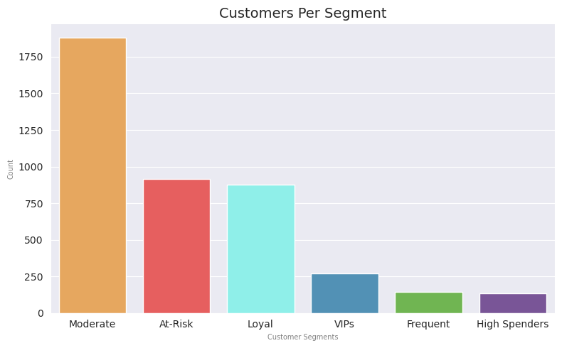
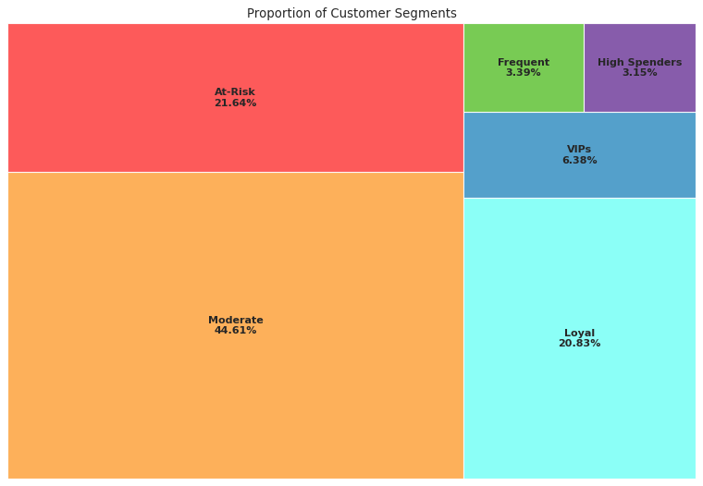
Modeling cont’d.
Customer Segmentation
Customer Segmentation Analysis and Recommendations
Segment | Description | Recommendations
MODERATE | Moderately frequent buyers that are not necessarily high spenders. Majority in this segment made recent purchases. | Offer subscription on frequently bought items (whenever applicable) Recommend "Frequently bought together" items Implement customer retention and loyalty programs
AT-RISK | Least active segment. Less frequent buyers who are low-spenders and minimal recent purchases. | Requires attention and re-engaging Perform sentiment analysis. Send surveys and ask for reviews or feedback. Determine what can be improved and enhance the buying experience. Whenever possible, drop small rewards such as re-activation bonuses or discounts on their next purchase. Tease or entice with the benefits of becoming active or loyal customers.
LOYAL | Frequent buyers who are high spenders, and with its majority having purchased recently | Implement rewards and loyalty programs, and exclusive perks Run targeted ads for trending items and top items sold Offer subscription on frequently bought items (whenever applicable)
VIPS | High value, frequent buyers. | Offer exclusive perks and vouchers Pamper and enhance the shopping experience by offering expedited or free shipping (whenever applicable)
FREQUENT | Very frequent buyers. | Offer subscription on frequently bought items (whenever applicable) Implement customer retention and loyalty programs Offer expedited or free shipping vouchers (whenever applicable)
HIGH SPENDERS | High-spending buyers | Implement customer retention and loyalty programs Offer discounts on bulk purchases or reaching certain amount (whenever applicable) Enhance customer experience and services

Slide 12
Sources:
Github Project Repository | Customer Segmentation for an Online Retail
Machine Learning Libraries | Scikit-Learn Clustering Hyperopt Hyperparameter Optimization
Data Source | UCI Machine Learning Repository | Online Retail II

Slide 13



Thank you
Eduardo Mosada Jr.
edu.mosada.jr@gmail.com
https://github.com/ds-edu/ https://www.linkedin.com/in/edumosada/

